Slide 2

Are we recording?

Slide 3
AI-Powered Text Generation Portal
October 7th, 2025

Slide 4
Note for future : Week 6 was a buffer week, so no slides or recording
Notes:
Did anyone do the extra credit?

Slide 5
How was week 4, 5, 6 assignment?
Notes:
Did anyone do the extra credit?

Slide 6

Attaching the generator to a UI

Slide 7
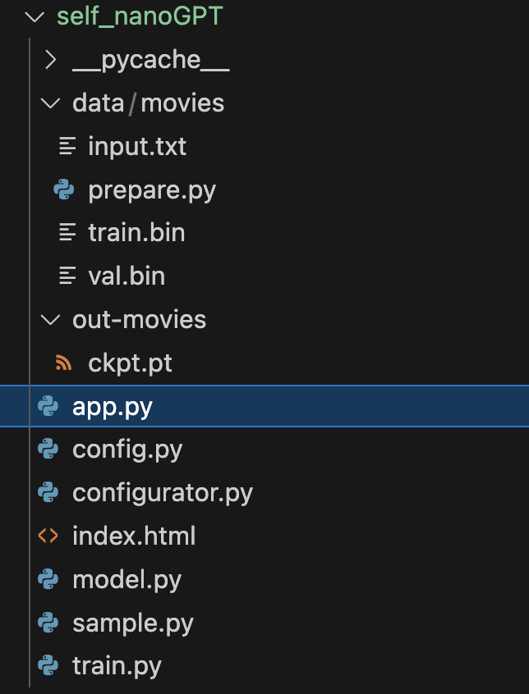
Quick note on project
This is what your directory structure should look like to avoid any errors ->

Slide 8
Connecting your generator to a UI
Inside your uv environment install flask using : uv add flask
This can be done using two files
index.html which contains the frontend
app.py which contains the backend

Slide 9
Contents of index.html
Create a basic button
Create a div where the generated text will be displayed
Using javascript add an onClick handler
In the onClick make a call to the /generate API
Get the data from the response and paste it into the div meant for the generated text

Slide 10
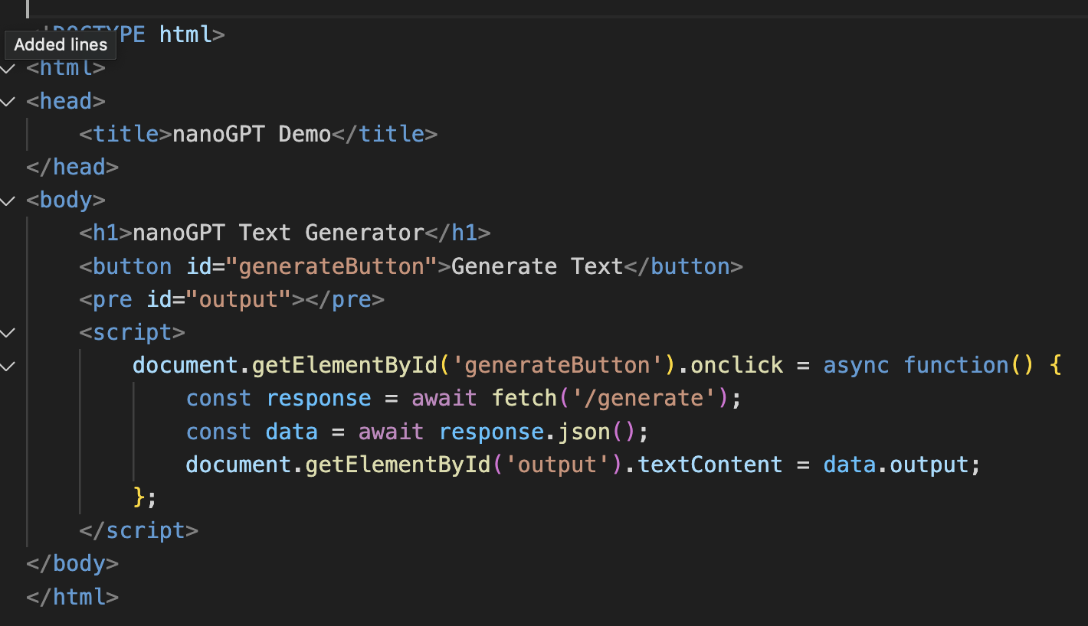
Contents of index.html

Slide 11
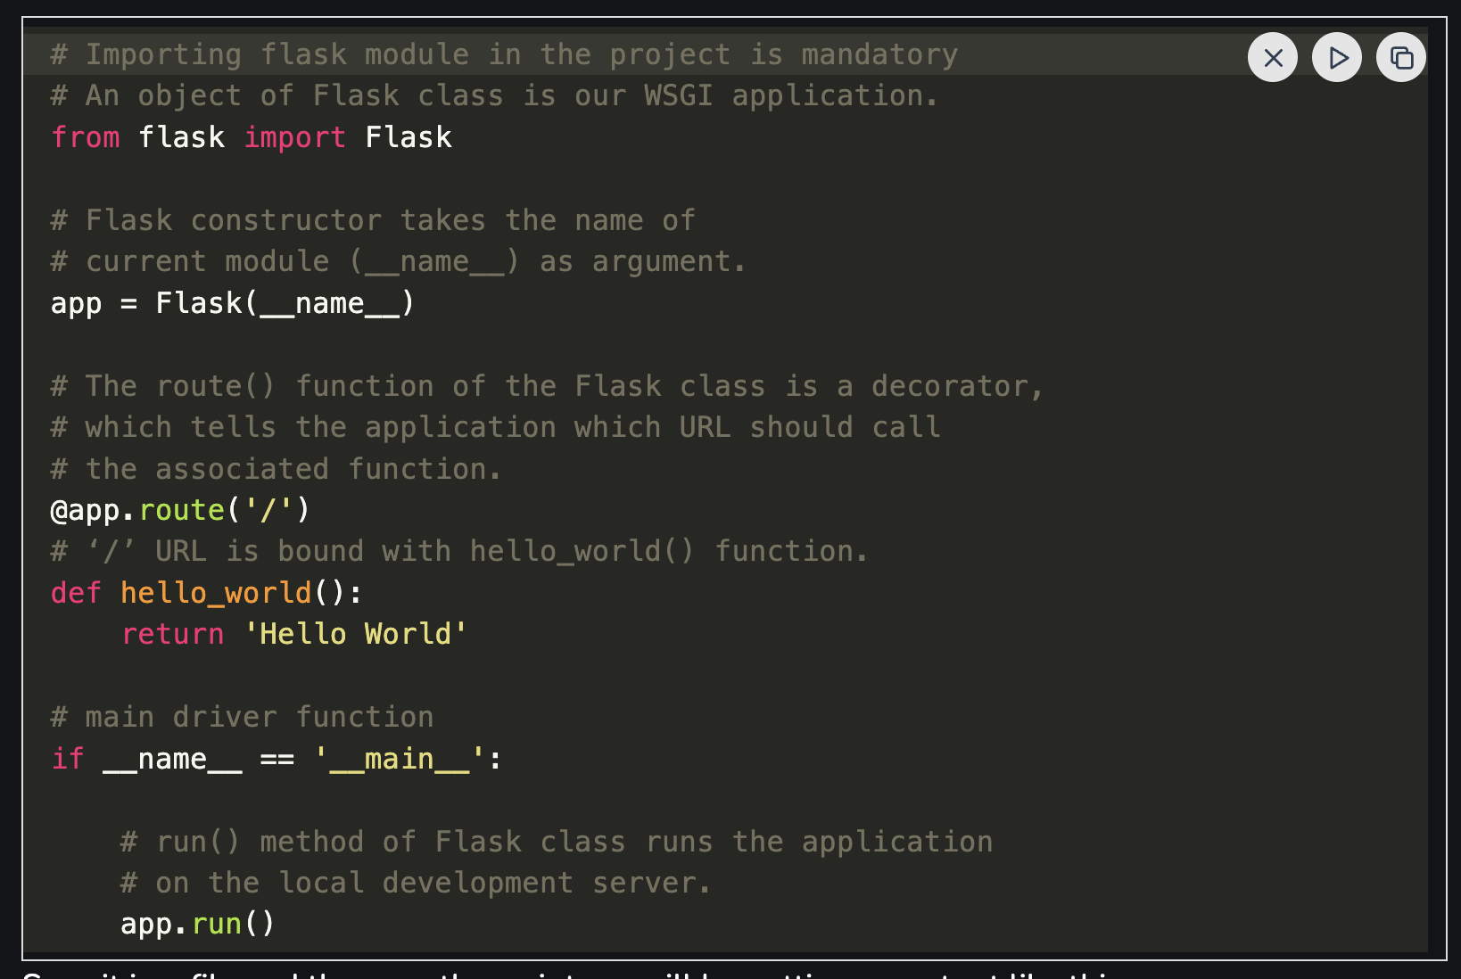
Basics of flask
https://www.geeksforgeeks.org/python/flask-creating-first-simple-application/

Slide 12
Contents of app.py
Replace the root "/" with to display contents of the index.html file
@app.route('/')
def index():
return send_from_directory('.', 'index.html')

Slide 13
Contents of app.py
Now add an API to handle the click of the generate button which will call the subprocess "sample.py"

Slide 14
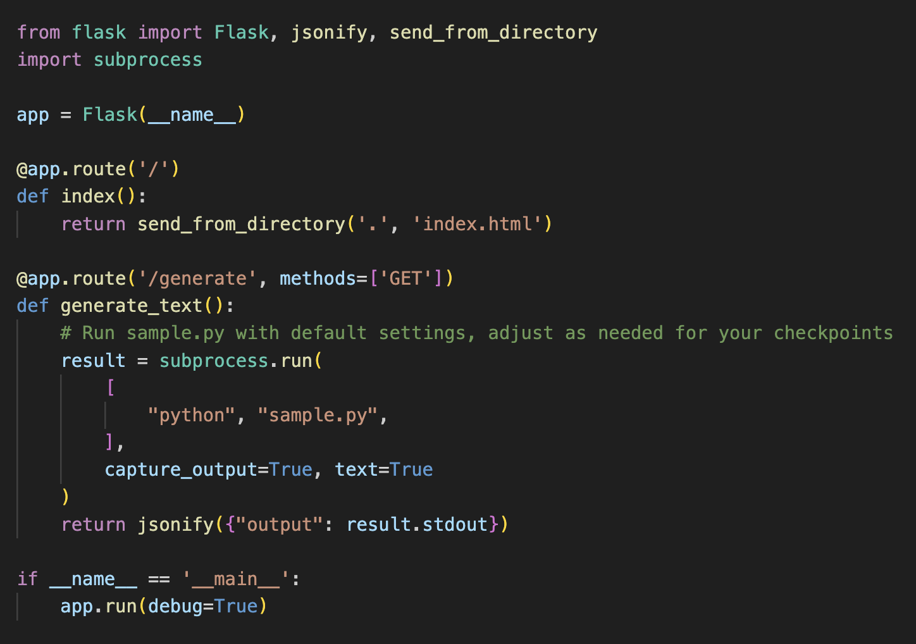
Contents of app.py

Slide 15
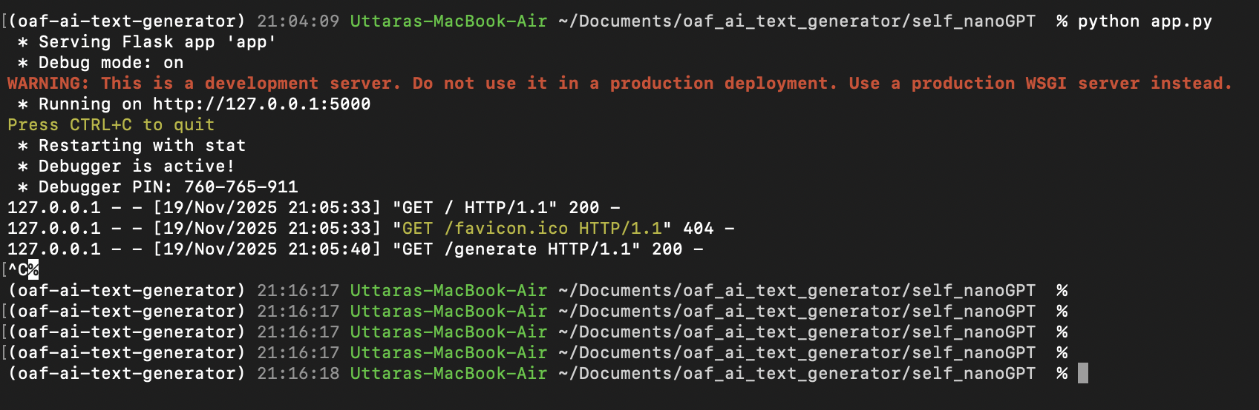
Running your application
From your terminal, inside the myNanoGPT directory run python app.py
You will see the following output, your application will be on http://127.0.0.1:5000

Slide 16
Modifications you can make
You need to get rid of any of the redundant prints and logs, so that only the generated text is printed on the UI
The provided sample is too basic, you can jazz it up and clean up the UI
You can do this project for two datasets example movies and twitter, and after doing all the steps from Week 4, 5, 6 you can create an option to select what type of text you want generated – eg movies or twitter and call the sample.py file with the right out-directory that contains the model's
You can add a loading state to your UI to display in the gap between clicking the generate button and the printing of the generated text

Slide 17

Questions?

Slide 18


